Slide 1
Using the Knowledge Expression and Reasoning method to solve the problems in Formal Verification
Renyan Feng
Guizhou University & Vrije University Amsterdam
Supervisors: Erman Acar, Stefan Schlobach, Yisong Wang

Slide 2
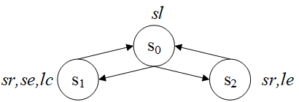
Example
Model Structure M:
Car Engine Manufacturing Scenario:
Sedan car: safety restriction, small engine, low-carbon emission
Sports car: safety restriction, large engine
Sedan car: safety restriction, small engine, low-carbon emission
Sports car: safety restriction, large engine
P={sl,sr,se,le,lc}
obsolete
New engine technology:
the company aims to adapt the sedan production to electrical engines.

Slide 3
Two points
Forget:
The Strongest Necessary Condition (SNC) and the Weakest Sufficient Condition (WSC)

Slide 4
Overview
已有成果
Forgetting in bounded CTL
A Resolution-based method in CTL
To do
Construct a system to compute the CTL
Solve a problem in Verification with the system
Schedule
Thanks

Slide 5
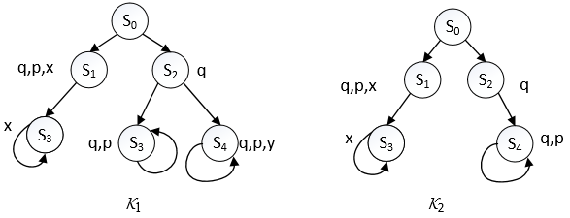
V-bisimilar
Two V-bisimilar initial K-structures, V={y}.
P={p,q,x,y}
{y}-bisimilar
They are behaviourally the same on P\{y}.

Slide 6
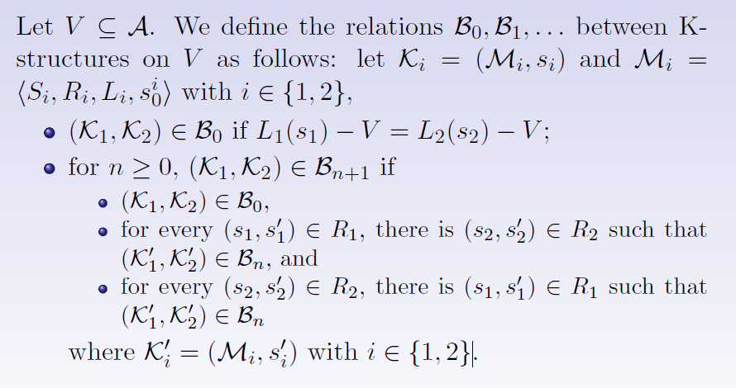
Set-based bisimulation

Slide 7
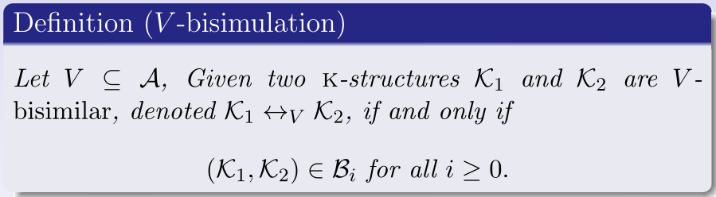
Set-based bisimulation
We use these V-bisimulation also for computation trees.

Slide 8

Example
Two states s and s' in M are V-distinguishable, if there exists
a least constant k such that , denoted as

Slide 9
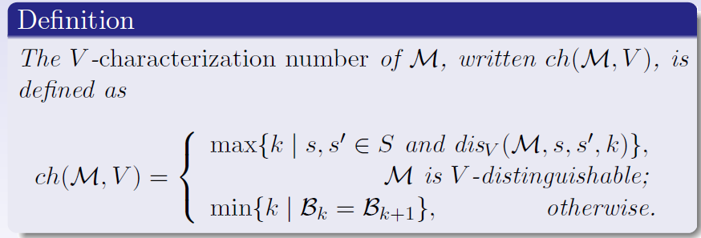
V -characterization number

Slide 10
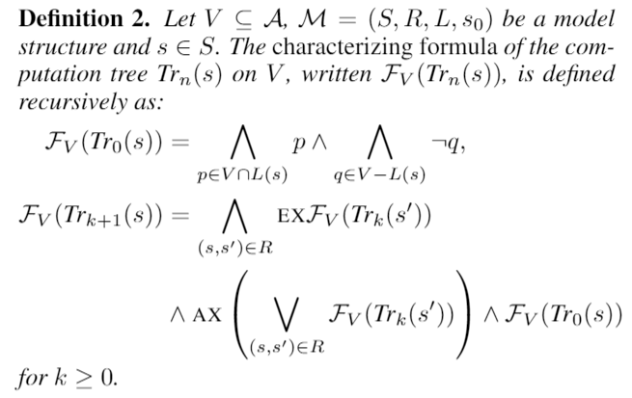
Characterizing formula - computation tree

Slide 11
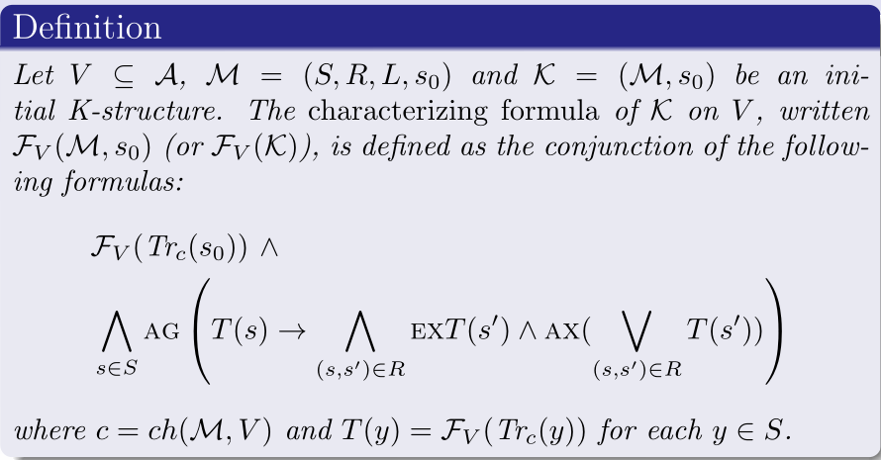
Characterizing formula - initial K-structure

Slide 12
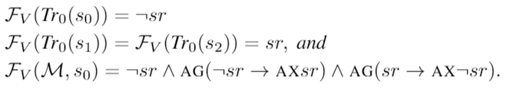
Example

Slide 13
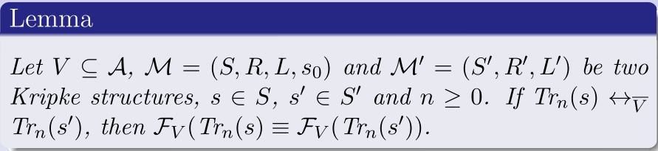
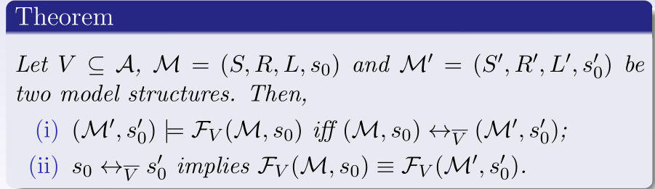
Important results

Slide 14
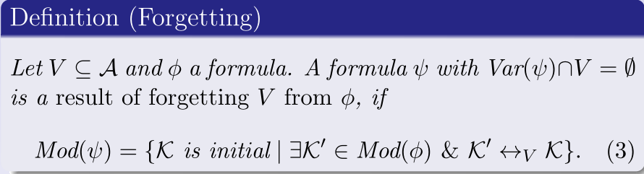

Forgetting
The forgetting result is denoted by
Such a formula always exists, which is equivalent to

Slide 15
Example

Slide 16
SNC and WSC
Two logical notions introduced by the Dutch computer scientist Edgar Dijkstra are informative:
Strongest Necessary Condition (SNC) is the most general consequence；and
Weakest Sufficient Condition (WSC) is the most specific abduction

Slide 17
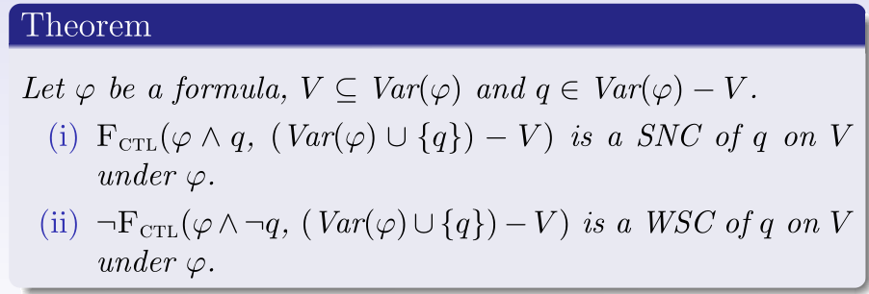
The relationship - SNC (WSC) and Forgetting
Dual
SNC
WSC

Slide 18
Contributions
A Forgetting framework for CTL
Representation Theorem
Complexity results
Algebraic Properties of the Forgetting operator: Homogeneity, Commutativity, and others
Computing SNC and WSC by using Forgetting in CTL

Slide 19
A Resolution-based method in CTL

Slide 20
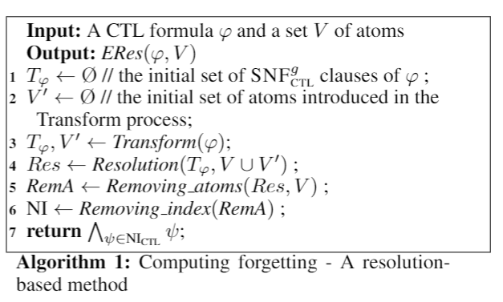
Algorithm
Extend the resolution method of Zhang at al.
new atoms

Slide 21
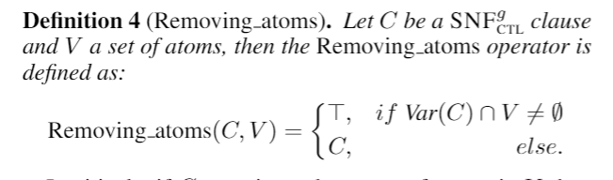
Eliminate operator in V

Slide 22
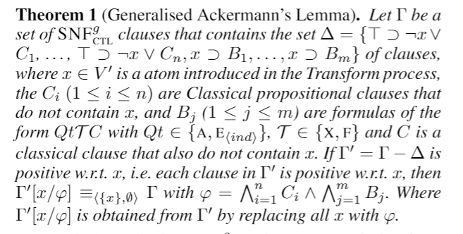
Generalised Ackermann's Lemma
To eliminate the new atoms introduced in the Transform process.

Slide 23
To do

Slide 24
To do
Construct a system to compute the CTL with Prolog
Solve a problem in Verification with the system.....

Slide 25
Schedule
Construct a system in 6 months
Find a good Example of Verification to use our system in 1 to 2 months
Use our system to solve this Example.

Slide 26
Thanks!
Questions

